Slide 1
UNIT – 3 Introduction to project management

Slide 2
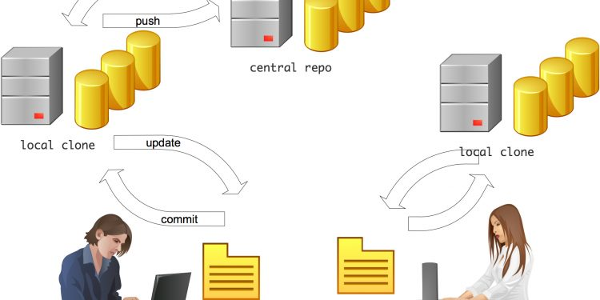

Slide 3

What is Project Management?
Project management is the use of specific knowledge, skills, tools and techniques to deliver something of value to people.

Slide 4
What Is Source Code Management?
Source code management is the concept of storing the source code for your software applications in a centralized, managed place. It’s used by software development teams, who are the ones that gain the most benefit from it due to the multiple developers they have.
The main people involved in source code management are the developers or programmers. They are the ones that are working on the code, making changes, adding features and requirements. The source code is a product of their work and it needs to be managed in some way.
Testers are also main users of source code. When they are required to test applications or features, they benefit from a source code management system and process, as it ensures they are working with accurate code and helps the team run better.

Slide 5
What Are The Benefits Of Source Code Management?
There are several reasons why we should manage the source code that we write:
Work together in teams. A source code management system allows multiple developers to access and change different areas of the code, without interfering with each other’s work. This is a big benefit for large teams of developers.
Version history. The system will keep a history of all saved changes to the code. This not only allows you to see what has changed in a file, but allows you to go back to a previous version if needed.
Generate release notes. Code can be linked to a release, and as a result, release notes can be generated. This means time is saved in generating it manually and searching for the changes.
Backup of code. A centralized place on a server where the source code is stored ensures there is a main location for the code (other than the developer’s machine). It also allows for easy backup of the code, depending on your server setup.

Slide 6
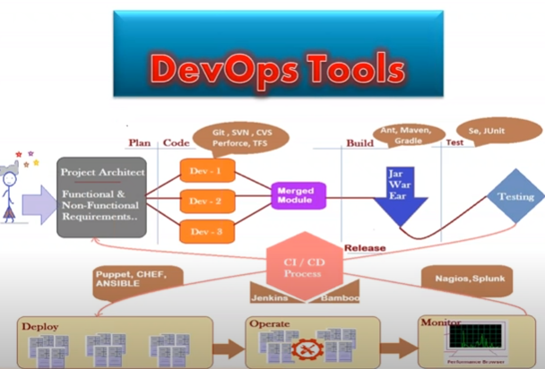

Slide 7
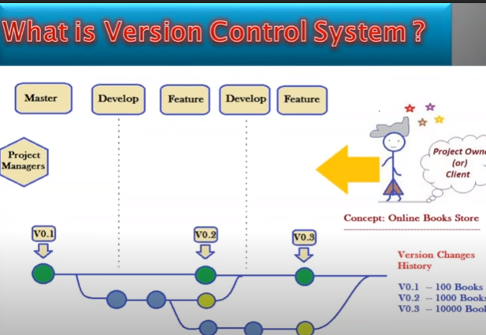

Slide 8
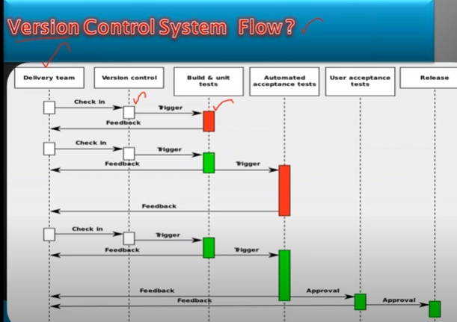

Slide 9
How Does Source Code Management Work?
The process works by a development team or company having a centralized server that stores all of the required code. This server is called the repository – the storage place for code. It can run various source code management systems, which are used to manage changes and different projects.
The system stores a copy of the source code as individual files, just like the developers have written it. When you want to make changes to some code, you perform what’s called a “check out” on the file. You get your own copy of the file in your environment. It also creates a “lock” on the file on the server, which means others can’t check out the same piece of code. This is to minimise the chances of someone overwriting your work.
Once you’ve made the changes, and tested them, you can save them onto the server using a process called “commit” or “check in”. This saves your code onto the server, replacing the existing file, and incrementing the version. It also removes the lock that was placed previously. You can usually add comments to this process, which allows you to specify what was changed.
This can all be done by different developers on different files. The source code management system will store this code and manage the changes that have been made.

Slide 10
Importance of Source Code Management¶
Track Changes – Changes can be tracked as someone making a change leaves a commit message about it.
Synchronization – The up-to-date codes can be fetched from the repository.
Backup and Restore – Files are saved at any time and restored from the last saved one.
Undoing – You can undo both the last known version and the last one created a long time ago.
Branching and Merging – Changes are made on a branch and after being approved, they can be merged with the master branch.
Identifying Conflicts and Preventing Overwrites – Overwrites are prevented and in case of conflicts, they are identified. SCM notifies the developers so that they can review these conflicts and resolve them.

Slide 11
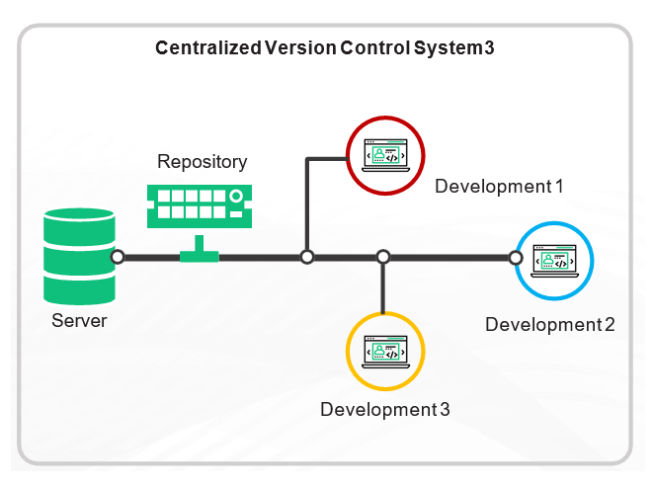

Slide 12
What is a “version control system”? (OR SCM)
Version control systems are a category of software tools that helps in recording changes made to files by keeping a track of modifications done to the code.
Why Version Control system is so Important?
As we know that a software product is developed in collaboration by a group of developers they might be located at different locations and each one of them contributes in some specific kind of functionality/features.
So in order to contribute to the product, they made modifications in the source code(either by adding or removing). A version control system is a kind of software that helps the developer team to efficiently communicate and manage(track) all the changes that have been made to the source code along with the information like who made and what change has been made. A separate branch is created for every contributor who made the changes and the changes aren’t merged into the original source code unless all are analyzed as soon as the changes are green signaled they merged to the main source code. It not only keeps source code organized but also improves productivity by making the development process smooth.

Slide 13
Benefits of the version control system:
a) Enhances the project development speed by providing efficient collaboration,
b) Leverages the productivity, expedite product delivery, and skills of the employees through better communication and assistance,
c) Reduce possibilities of errors and conflicts meanwhile project development through traceability to every small change,
d) Employees or contributor of the project can contribute from anywhere irrespective of the different geographical locations through this VCS, e) For each different contributor of the project a different working copy is maintained and not merged to the main file unless the working copy is validated. A most popular example is Git, Helix core, Microsoft TFS,
f) Helps in recovery in case of any disaster or contingent situation,
g) Informs us about Who, What, When, Why changes have been made.

Slide 14
Use of Version Control System:
A repository: It can be thought of as a database of changes. It contains all the edits and historical versions (snapshots) of the project.
Copy of Work (sometimes called as checkout): It is the personal copy of all the files in a project. You can edit to this copy, without affecting the work of others and you can finally commit your changes to a repository when you are done making your changes.
Types of Version Control Systems:
Local Version Control Systems
Centralized Version Control Systems
Distributed Version Control Systems

Slide 15
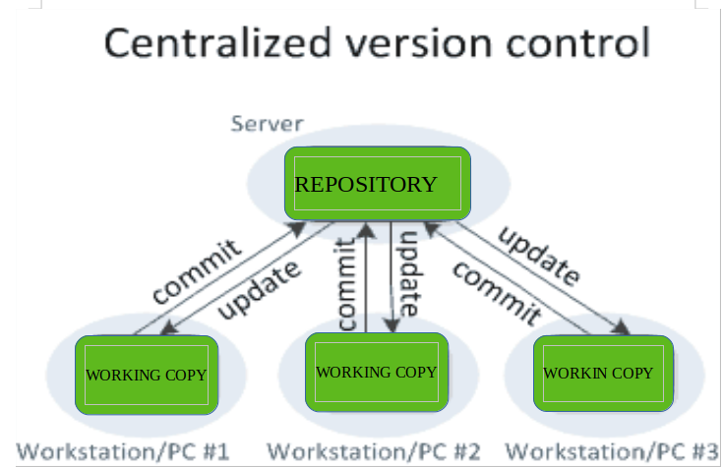
Local Version Control Systems: It is one of the simplest forms and has a database that kept all the changes to files under revision control. RCS is one of the most common VCS tools. It keeps patch sets (differences between files) in a special format on disk. By adding up all the patches it can then re-create what any file looked like at any point in time.
Centralized Version Control Systems: Centralized version control systems contain just one repository and each user gets their own working copy. You need to commit to reflecting your changes in the repository. It is possible for others to see your changes by updating.
Two things are required to make your changes visible to others which are:
You commit
They update

Slide 16
The benefit of CVCS (Centralized Version Control Systems) makes collaboration amongst developers along with providing an insight to a certain extent on what everyone else is doing on the project. It allows administrators to fine-grained control over who can do what.
It has some downsides as well which led to the development of DVS. The most obvious is the single point of failure that the centralized repository represents if it goes down during that period collaboration and saving versioned changes is not possible. What if the hard disk of the central database becomes corrupted, and proper backups haven’t been kept? You lose absolutely everything.
Distributed Version Control Systems: Distributed version control systems contain multiple repositories. Each user has their own repository and working copy. Just committing your changes will not give others access to your changes. This is because commit will reflect those changes in your local repository and you need to push them in order to make them visible on the central repository. Similarly, When you update, you do not get other’s changes unless you have first pulled those changes into your repository.
To make your changes visible to others, 4 things are required:
You commit
You push
They pull
They update
The most popular distributed version control systems are Git, Mercurial. They help us overcome the problem of single point of failure.

Slide 17
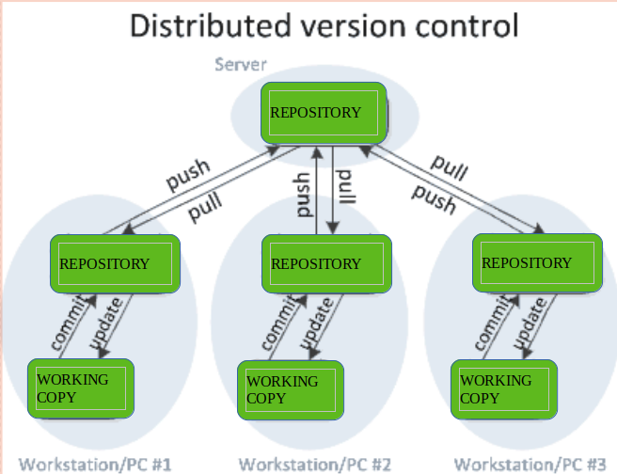

Slide 18
Purpose of Version Control:
Multiple people can work simultaneously on a single project. Everyone works on and edits their own copy of the files and it is up to them when they wish to share the changes made by them with the rest of the team.
It also enables one person to use multiple computers to work on a project, so it is valuable even if you are working by yourself.
It integrates the work that is done simultaneously by different members of the team. In some rare case, when conflicting edits are made by two people to the same line of a file, then human assistance is requested by the version control system in deciding what should be done.
Version control provides access to the historical versions of a project. This is insurance against computer crashes or data loss. If any mistake is made, you can easily roll back to a previous version. It is also possible to undo specific edits that too without losing the work done in the meanwhile. It can be easily known when, why, and by whom any part of a file was edited.

Slide 19
What Are The Benefits Of Source Code Management?
There are several reasons why we should manage the source code that we write:
Work together in teams. A source code management system allows multiple developers to access and change different areas of the code, without interfering with each other’s work. This is a big benefit for large teams of developers.
Version history. The system will keep a history of all saved changes to the code. This not only allows you to see what has changed in a file, but allows you to go back to a previous version if needed.
Generate release notes. Code can be linked to a release, and as a result, release notes can be generated. This means time is saved in generating it manually and searching for the changes.
Backup of code. A centralised place on a server where the source code is stored ensures there is a main location for the code (other than the developer’s machine). It also allows for easy backup of the code, depending on your server setup.

Slide 20
Almost all source code contains some format of delicate information, whether it be configuration-related information such as database credentials or information on how the web application functions, such as a web template.
If such information is disclosed, this information potentially could be used by an attacker to discover logical flaws and escalate into a successive chain of attacks. These include attacks such as SQL injection, database takeovers, cross-site scripting, remote code execution and, sometimes distributed denial of service.
To achieve solution for conducting a risk-free and systemic migration, we need to plan three stages for the code migration process: pre-migration, migration and post-migration.

Slide 21
Key Considerations During Pre-Migration
License cost
Administration cost
Developer productivity
Security of data
Training of team
Total cost of ownership
Knowledge on all connected tools with application lifecycle management
Agile adoption policies and CI practices
Team structure – distributed or co-located?
File types – Do you have large binary files?
Need file locks?
Users have the appropriate permissions to fetch and push
Builds are successful, and all your tests are passing

Slide 22
Key Considerations or Challenges During Migration
Test environment
Capacity planning
Compute capacity
Benchmark the current version control system
Network connectivity
Access between source and target servers
Load testing
Access control
Aim to migrate over a weekend when nobody needs to check-in
Key Considerations During Post-Migration
Data integrity verification
Data size check
Automated acceptance testing and reporting
Dependencies are intact and build doesn’t break
Link between files and folders is not broken
Load testing
Backup and sync jobs

Slide 23
Moving to Distributed Version Control from Centralized Version Control
When migrating code from a centralized version control system such as Apache Subversion (SVN) to a distributed version control such as GIT, here are the steps to take:
Evaluate the tools and methods you’re planning to utilize
Build and test
Code reviews
Release management
Select a branching strategy for GIT
long-lived feature branch
Short-lived feature branch
Bug fix branch
Dev branch

Slide 24
Decide whether you want to migrate history; if yes, then determine how you will achieve this—you may need another third-party tool to resolve your task.
There are many tools available in market that can migrate a whole history of all branches from a centralized tool to GIT.
Almost all version control systems collect how files change between versions, including rename, merge and rollback. GIT version control tool stores versions as a snapshot of the entire repository.
Retain your old version control system for a set time after migration.
During and after a migration, developers sometimes need access to the history in the old version control system, so you can’t just shut the old system down once you’ve migrated.
There should be some text file committed in GIT which should explain how/when the GIT branches were migrated from the old system and what all branches are migrated.
Remove binaries and executables from source control.
You should avoid commit large binary files to a repository. Once they’ve been committed to a repository, they will remain in the repository history and in every upcoming clone.
Migrating to Git provides you the opportunity to remove these binaries from your codebase and instead use a package management system.
Give knowledge transfer to your team in the concepts and practice used in GIT.
It is mandatory for developers to understand how Git stores change and how commits form a history of development and how all things work in GIT.
Identify training materials.
Perform the actual migration to GIT.

